Slide 1

TUPLE

Slide 2
Tuple is a lightweight data structure that allows you to group
together multiple elements of different types.
It provides a convenient way to represent and work with heterogeneous data.
Tuples are immutable, meaning their values cannot be changed once set. You can create a tuple using the Tuple class or use tuple literals for brevity.
They are commonly used when a method needs to return multiple values. Remember, tuples can enhance code readability and maintainability by encapsulating related data in a single entity.
you can declare and use tuples in various ways. Here are examples

Slide 3
illustrating different ways to work with tuples
1) Using Tuple Class:
The user can demonstrate on a projector or computer, or print the presentation and make it film
2) Tuple Literal with Elements:
The user can demonstrate on a projector or computer, or print the presentation and make it film

Slide 4
illustrating different ways to work with tuples
3) Tuple with Named Elements:
4) Tuple Deconstruction:

Slide 5
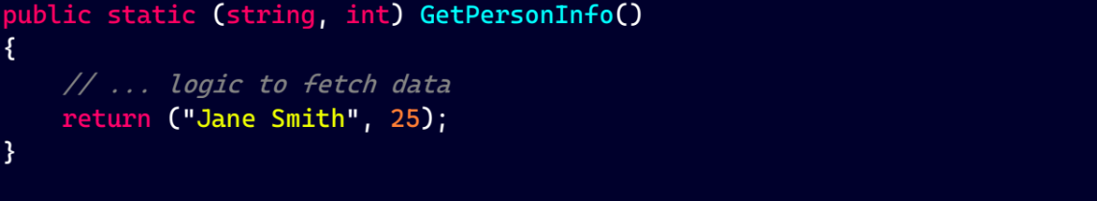
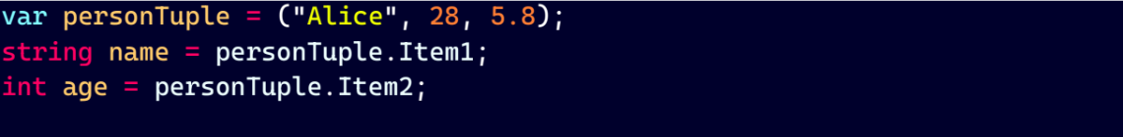
illustrating different ways to work with tuples
5) Returning Tuple from Method:
6) Accessing Tuple Elements by Index:

Slide 6
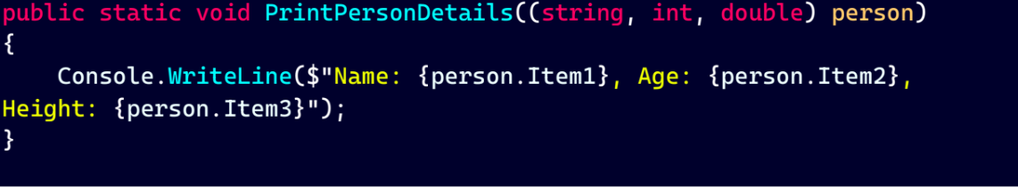
illustrating different ways to work with tuples
7) Creating Named Tuple Elements with Initialization:
8) Passing Tuple as Method Parameter:

Slide 7
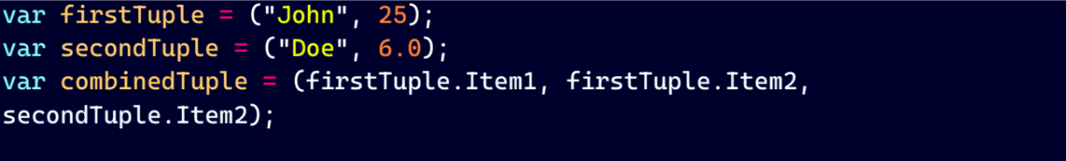
illustrating different ways to work with tuples
9) Combining Tuples:

Slide 8
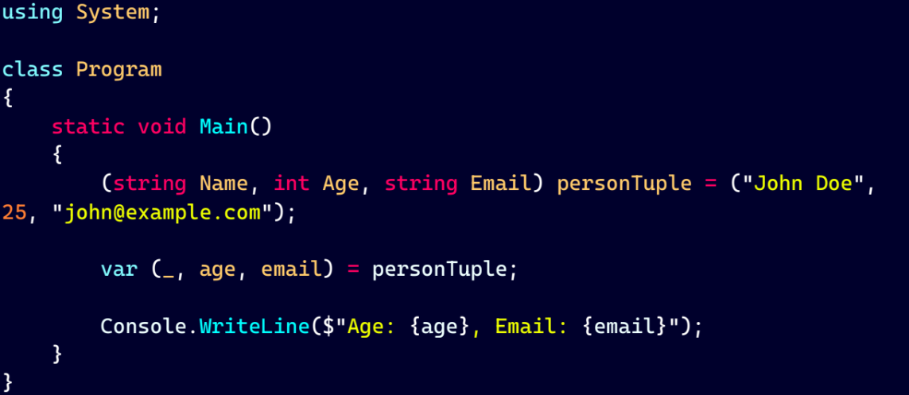
Discard in tuple:
while Deconstructing a tuple if some value is not needed then Discard is used. Here is example of that
In this Name is not needed so it is discarded.

Slide 9
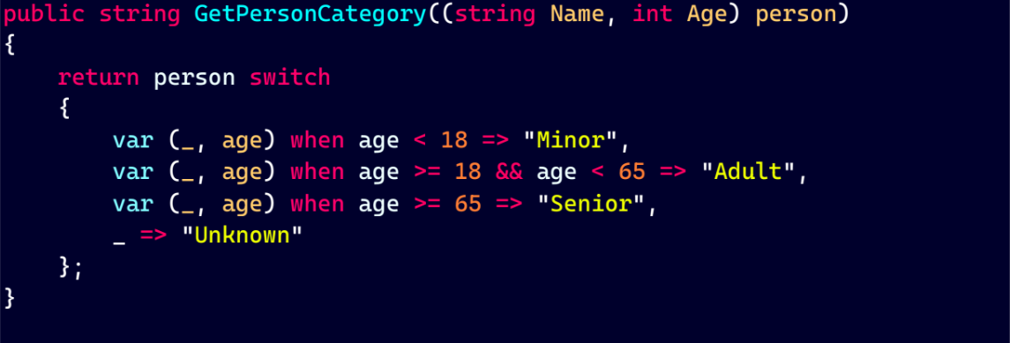
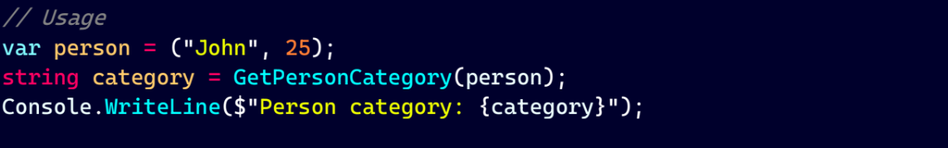
Example of usage of tuple:
Example in C# using pattern matching with tuples

Slide 10
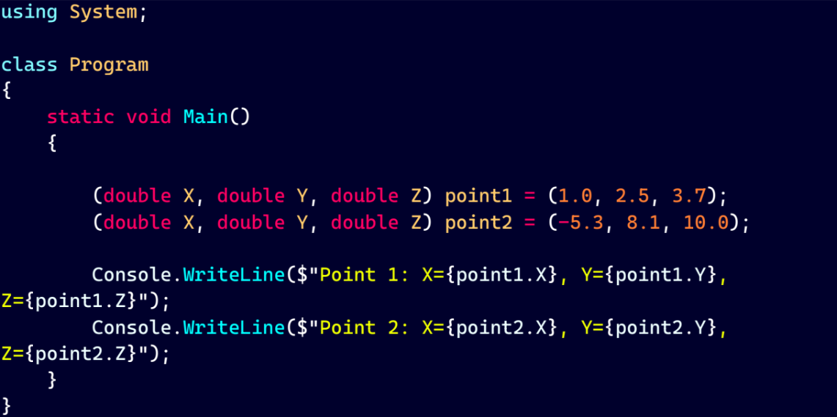
Real word Example:
It can be used in coordination system.

Slide 11
Thank you for listening and watching

